Slide 1
World Bank Procurement Procedures
Module - Technical Specifications for RTDAS
Anish
….. Hydro-Informatics Expert
The World Bank

Slide 2
World Bank Procurement
Procurement of Civil Works
Consultancy Services
Non Consultancy Services
Goods
  Hydrological Information System

Slide 3
About The Module
What is Purpose of This Training?
  Share the experience from Other States
  Prepare the Bidding Documents
  Bid Evaluation
  Execution of Works
  Inspection and Acceptance of Works
Who are the Target Audience?
  Senior Officers from Implementing Agencies
  Executive Officers
  Field Engineers
  Procurement Officers

Slide 4
Hydrological Information System
(HIS)
A comprehensive Hydrological Information System should be viewed as a valuable national resource equal to other resources that enable India to have economic success and a good quality of life.
As such it must be well designed, implemented, protected, and preserved which is why we’re here this week.

Slide 5

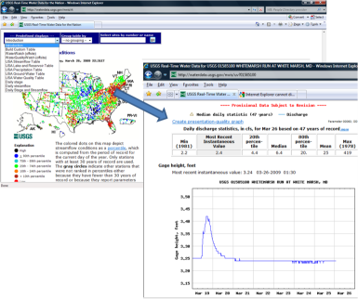
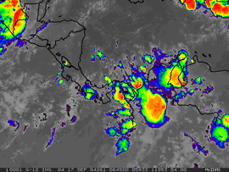
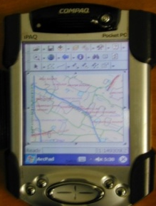
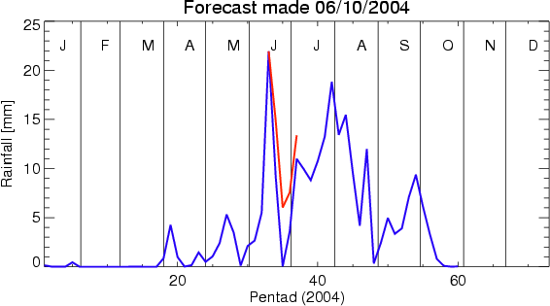
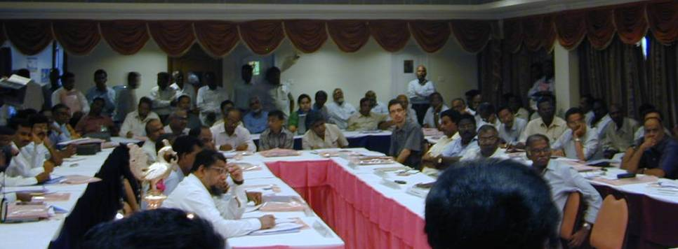
Some Modern HIS Benefits
Modeling Verification
Dissemination
Understanding Hydrological Processes
HIS
Flood Forecasting
Policy and Planning

Slide 6
Five Essential Elements of a Hydrological Information System
Network Design
Quality Management
System
Technology
HIS
Training
Data Management

Slide 7
Tender Document for RTDAS
Select the Instrument
Select the Site
  Site Survey
Specifications for Goods
Specifications for Services
Training Requirements
Personnel requirements
Services during Warranty, Operation and Maintenance
Testing, Inspection and Acceptance
Goes into Bid Document as Appendix

